Slide 2
Introduction to GLMs
Why can’t you be Normal?

Slide 3
Introduction to GLMs
Chapter 1: Linear model refresh
Chapter 2: Stochastic element
Chapter 3: The missing link
[Intermission]
Chapter 4: Deterministic element
Chapter 5: Holistic models
Chapter 6: Uses and risks of modelling

Slide 4
Chapter 1: Linear model refresh

Slide 5
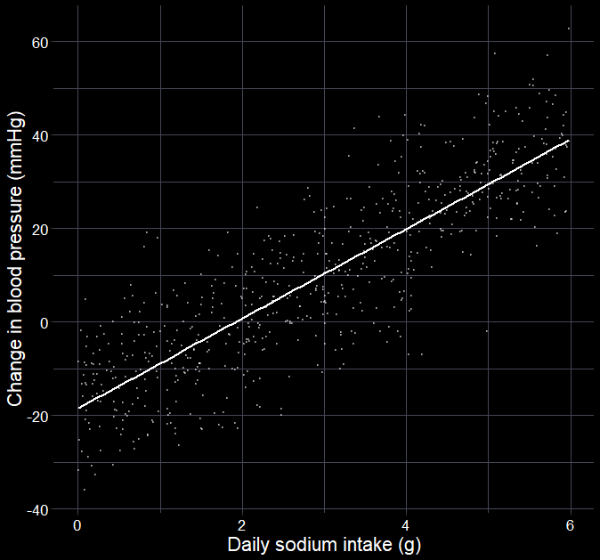
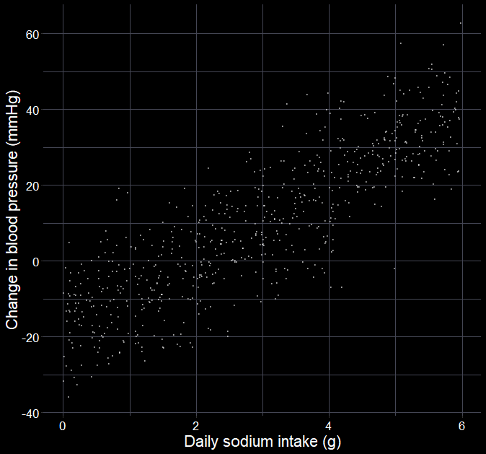

Can we reduce blood pressure?
$$y_{i}∼Normal(μ_{i},σ_{i})$$
$$μ_{i}=β_{0}+β_{1}×{Na}_{i}$$
Where:
$y$ is change in blood pressure
$i$ is the $i^{th}$ patient
$μ$ is the mean
$σ$ is the standard deviation
$β_{0}+β_{1}×Na_{i}$ is the linear predictor, where
$β_{0}$ is the intercept
$β_{1}$ is the slope for sodium

Slide 6
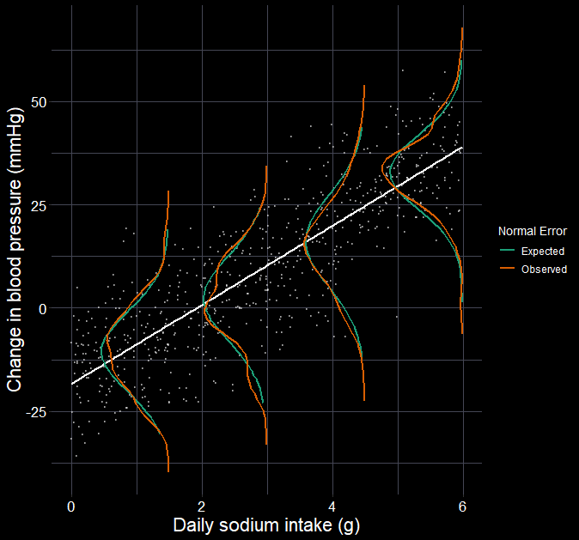




Can we reduce blood pressure?
$$σ=10.1$$
$$y_{i}∼Normal(μ_{i},σ_{i})$$
$$μ_{i}=β_{0}+β_{1}×{Na}_{i}$$
Now estimated as:
$$y_{i}∼Normal(μ_{i},10.1)$$
$$μ_{i}=−18.4+9.6×{Na}_{i}$$
$$β_{1}=9.6$$
$$β_{0}=−18.4$$

Slide 7
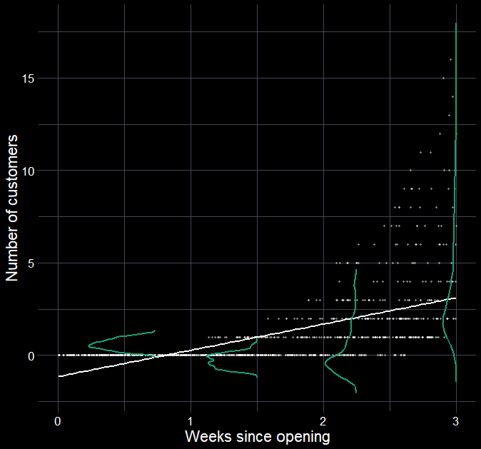
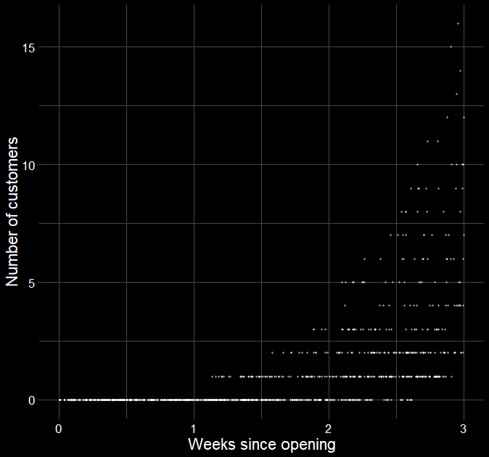
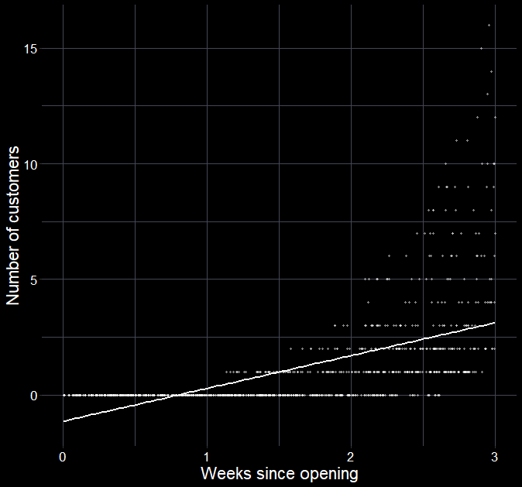

What if our error is not Normal?
What do you notice about the data?
Response must be non-negative
Response is integers
What if we force a linear model?
Can we have negative customers?
Is our randomness best captured with a $Normal$ distribution?

Slide 8
Chapter 2: Stochastic element

Slide 9
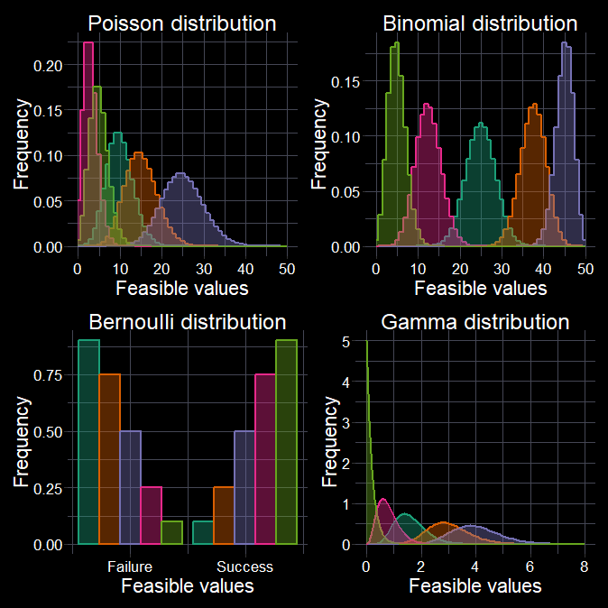
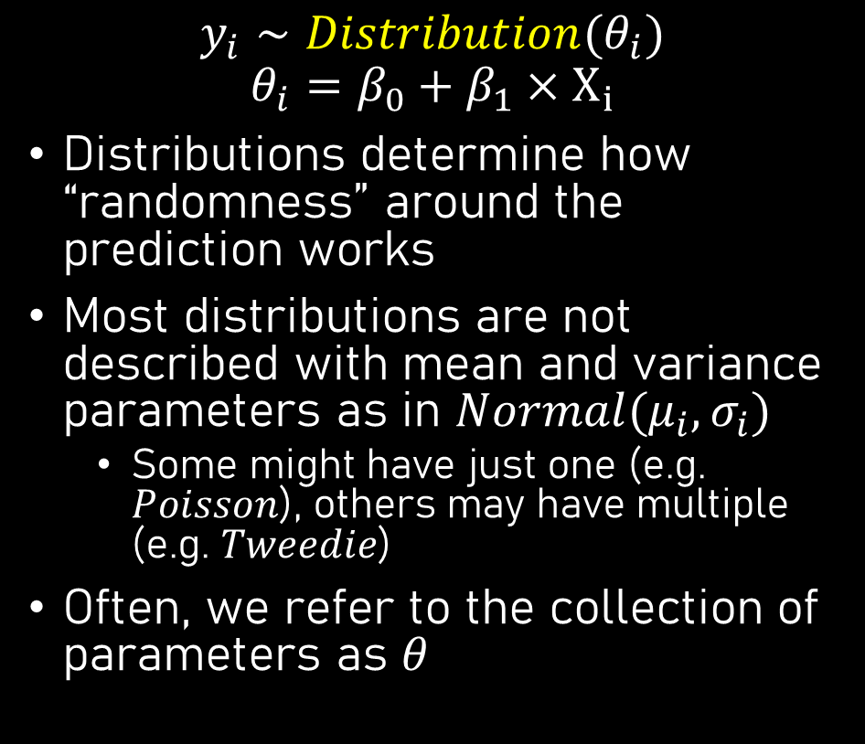
Allowing suitable randomness
$$y_{i}∼Distribution(θ_{i}) \\ θ_{i}=β_{0}+β_{1}×X_{i}$$
Distributions determine how “randomness” around the prediction works
Most distributions are not described with mean and variance parameters as in $Normal(μ_{i}, σ_{i})$
Some might have just one (e.g. $Poisson$), others may have multiple (e.g. $Tweedie$)
Often, we refer to the collection of parameters as $θ$

Slide 10
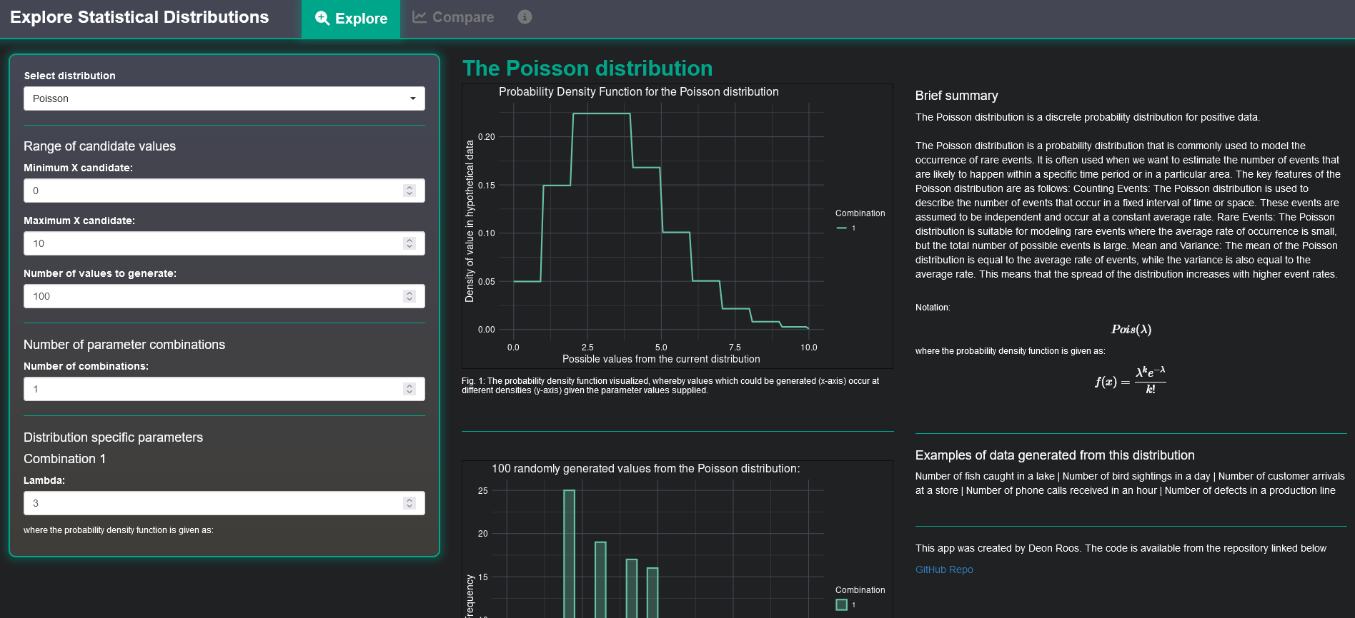
https://deonroos.shinyapps.io/Distributions/

Slide 11
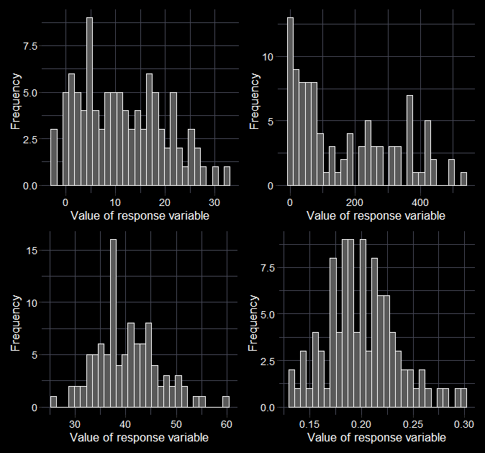




Beware the histomancer
Don’t plot histograms of your response to “determine” the distribution.
Think about the data:
What kind of values could I measure?
Are there limits to the values I could measure?
Of the distributions I know of, which one best describes my data?
$$Normal$$
$$Normal$$
$$Poisson$$
$$Beta$$

Slide 12
Chapter 3: Link functions

Slide 13
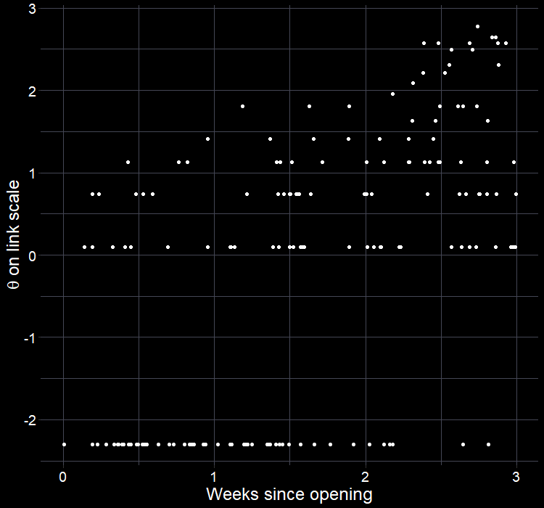
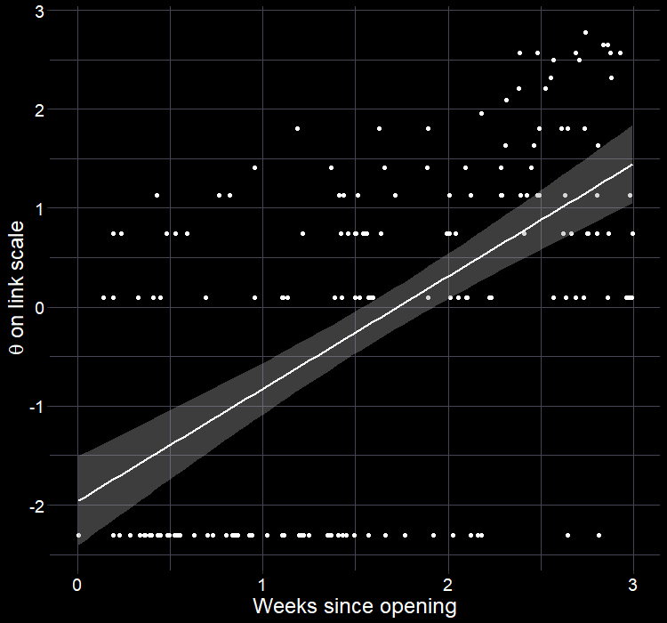
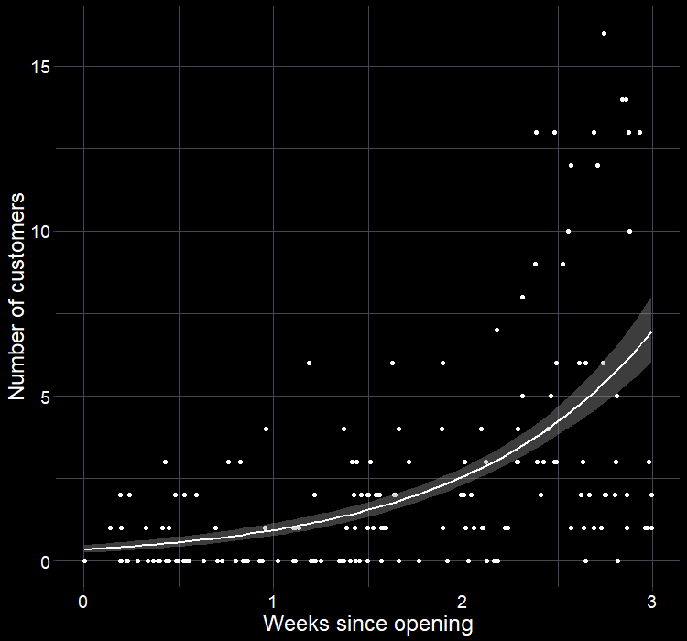
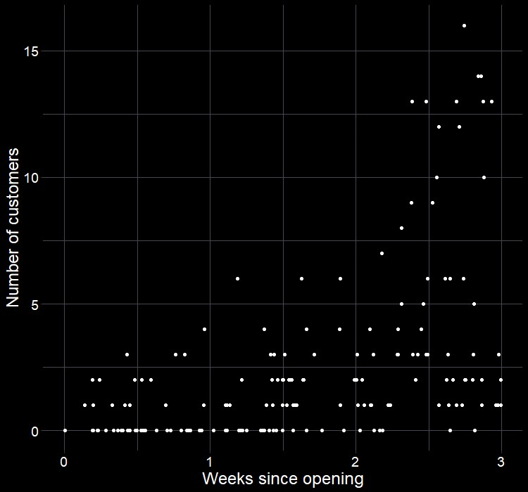
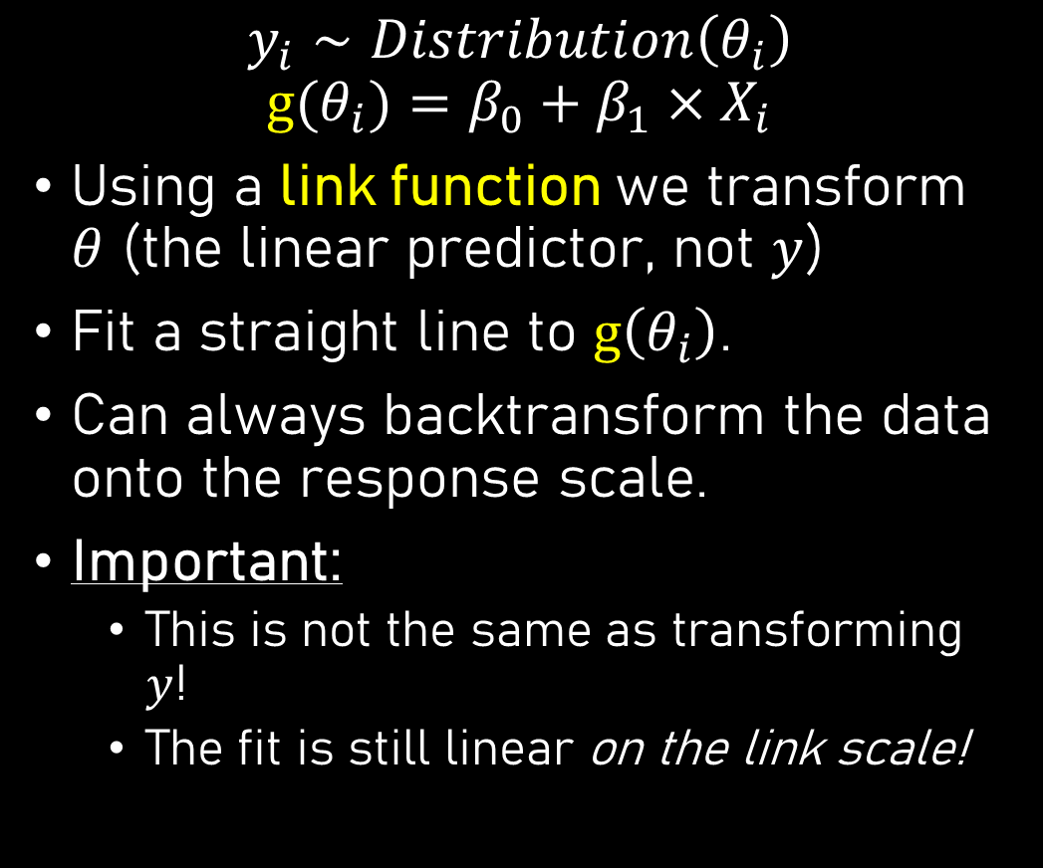
The missing link
$$y_{i}∼Distribution\left(θ_{i}\right) \\ g⁡(θ_{i})=β_{0}+β_{1}×X_{i}$$
Using a link function we transform $θ$ (the linear predictor, not $y$)
Fit a straight line to $g\left(θ_{i}\right)$.
Can always backtransform the data onto the response scale.
Important:
This is not the same as transforming $y$!
The fit is still linear on the link scale!

Slide 14

Why use link function
Link functions mathematically convert the linear predictor ($θ$) such that the values can exist between $−∞$ to $∞$
Generally, leads to a linear trend (great for fitting)
Maintains natural bounds of the data
Is the bridge between our response variable and the linear predictor

Slide 15
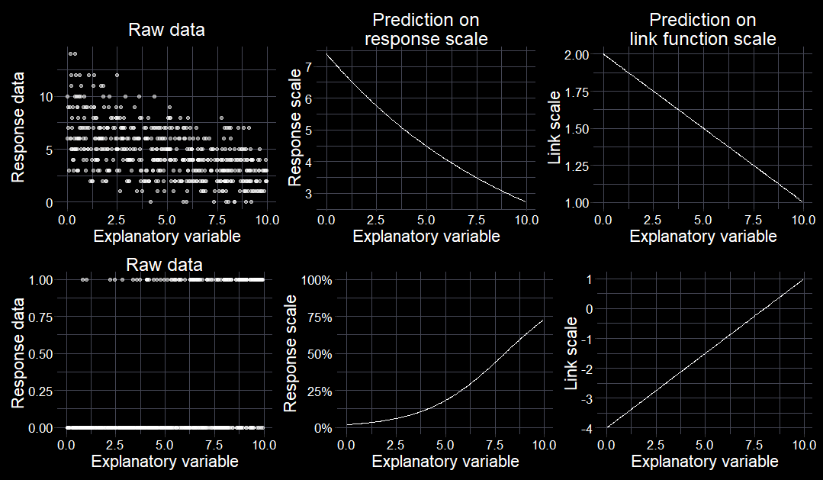
The missing link

Slide 16
Intermission

Slide 17
Chapter 4: Deterministic element

Slide 18

From a culture where drinking coffee in the morning is normal?
Parents drink coffee
Did you drink coffee yesterday?
Watched TV where mature characters drank coffee?
Was nostalgic for grandparent’s coffee?
Wanted to emulate characters?
Grandparent used to grind coffee by hand?
Drinks tea instead of coffee?
Grandparent’s room had butterflies in the wallpaper?
Believe drinking coffee helps with a hangover?
Saw a butterfly this morning?
Is hungover?

Slide 19


Did you drink coffee this morning?
Utterly trivial and simple question.
The response will be yes or no (1 or 0).
Given your answer, the more interesting question is why did you drink coffee (or not)?
There is some unknown probability, bound between 0% and 100%, that you will drink coffee, which is determined by some set of explantory variables.
$$y_{i}∼Distribution(θ_{i})$$
$${g(θ}_{i})=Xβ$$

Slide 20
Chapter 5: Holistic model

Slide 21




Stochastic and deterministic
$$y_{i}∼Distribution\left(θ_{i}\right)$$
$$g⁡(θ_{i})=β_{0}+β_{1}×X_{i}$$
This is the stochastic (i.e. “randomness”) element of the model
The distribution tells the model what type of response values are sensible, given we don’t expect perfect fit
E.g. the linear predictor ($θ$) might suggest you have a $95\%$ chance to drink coffee this morning (1), but maybe you didn’t (0)
But a value of 2.4 is not possible
This is the deterministic element of the model
We decide what goes into the deterministic element
E.g. I think $y$ happens because of $X$
And how $X$ is related to $y$
E.g. because you bought coffee yesterday, there is a 95% chance that you drank coffee this morning

Slide 22
Chapter 6: Uses and risks of modelling

Slide 23
Your key assumptions
Validity (Gelman & Hill)
Meaning: Your data can answer your research question
If broken: Monkey’s paw
You’re not answering the question you think you are
E.g.: Measuring test scores does not measure intelligence
Linearity (Gelman & Hill)
Meaning: Deterministic element is a linear function of your explanatory variables
If broken: Monkey’s paw
Answer is too simplistic
E.g.: Height does increase with age linearly
Independence of errors
Meaning: We have independent observations
If broken: Monkey’s paw
Overly confident in results
E.g.: We measure the height of one family to estimate average human height
Homogeneity of variance
Meaning: The randomness is handled by the distribution
If broken: Monkey’s paw
Results do not generalise
E.g.: More than just age influences height
Plus some assumptions that are specific to certain distributions

Slide 24


GLMs; oversimplified
Know your research question!
Think about your response variable (stochastic element).
Identify which distribution(s) best characterise your randomness.
Think about the process behind the data (deterministic element).
Combine into a model that can answer your question.
Use the default link function or any valid alternative.
Fit the model.
Check your assumption(s).
Answer your question (but beware the Monkey’s Paw).
$$y_{i}∼Normal\left(μ_{i}, σ_{i}\right) \\ μ_{i}=β_{0}+β_{1}×X_{i}$$
$$y_{i}∼Distribution\left(θ_{i}\right) \\ g⁡(θ_{i})=β_{0}+β_{1}×X_{i}$$
glm(y ~ x,
family = Dist(“g”), data = my_data)
lm(y ~ x,
data = my_data)

